Slide 1
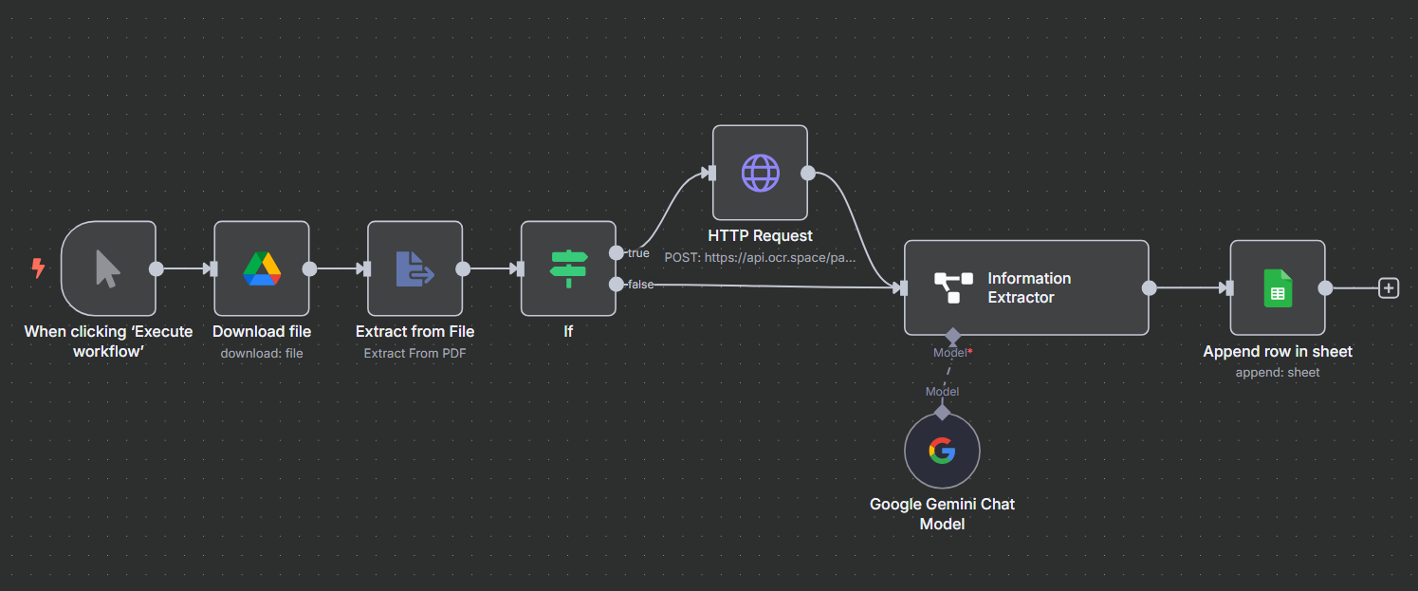

Smart Invoice Automation using AI & n8n
Supports both scanned and digital PDFs using OCR + AI-powered data extraction
Presented By : Sachin Savkare

Slide 2
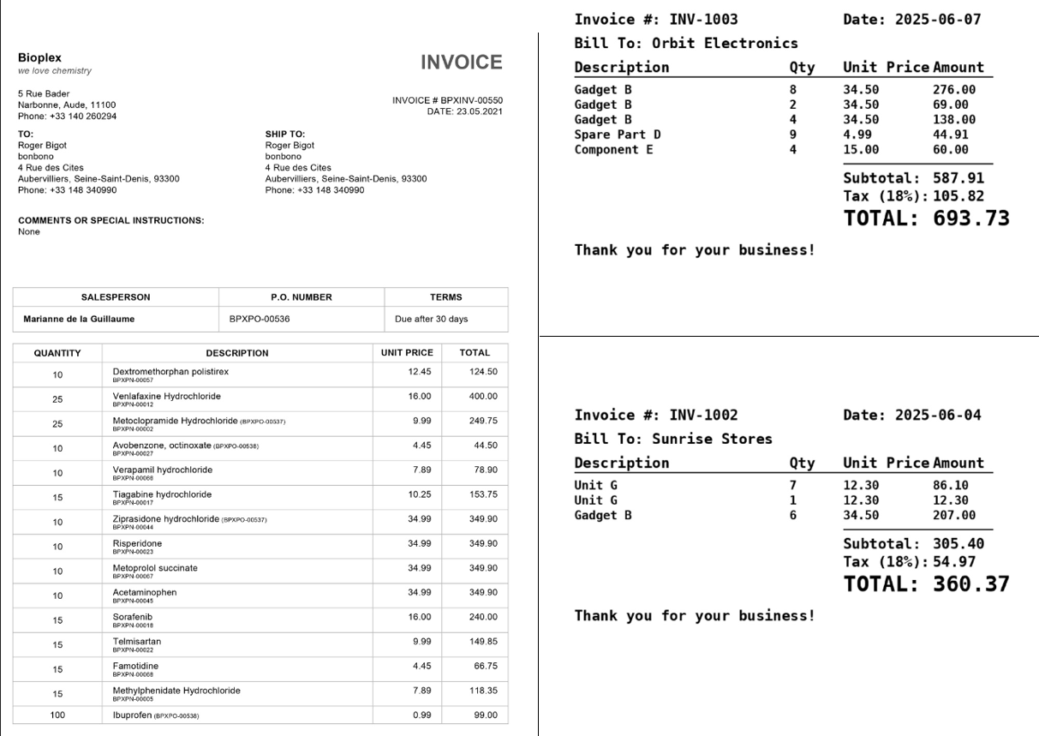
The Problem – Manual Invoice Processing
Invoices are stored in Google Drive as PDFs some scanned, some searchable.
Manual process involves:
Opening each file one by one
Manually reading and copying data into a tracker or sheet
Identifying formats manually (scanned vs readable)
⚠️ Issues with this process:
Time-consuming and repetitive
Prone to errors and missed entries
Not scalable for high volumes of invoices

Slide 3

The Automation Solution with n8n + AI
Built an end-to-end workflow in n8n to automate invoice data extraction.
Handles both scanned and searchable PDFs:
If text is available → extract directly.
If scanned → use OCR Space API to extract text from image.
Uses AI-based logic to extract structured fields like:
Invoice No, Date, Customer, Items, Amounts, etc.
Final data is auto-stored in Google Sheets with zero manual effort.
The workflow is scalable, error-free, and runs on one-click or schedule.

Slide 4
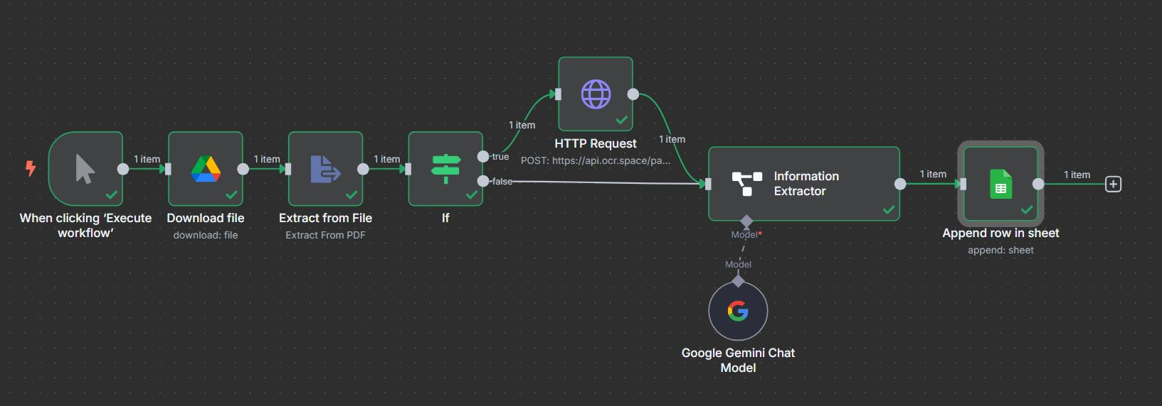
How the Workflow Works – Node by Node in n8n
1. Manual Trigger
User clicks “Execute” to start the workflow (can be scheduled later).
3. Extract Text from PDF
Attempts to extract text directly using native parser.
5. OC R Request to OC R. S p a c e
Sends base64 of scanned PDF and gets back extracted text.
2. Download PDF from Google Drive
Fetches invoice file (PDF) from predefined folder.
4. IF Condition: Is Text Empty?
If text is found → move to Info Extraction.
If empty (scanned) → go to OCR API.
6. Information Extractor (AI)
Parses and structures text into key fields like:
Invoice Number, Date, Customer, Items, Totals, etc.
7. Append to Google Sheet
Automatically writes structured invoice data to the target Google Sheet.

Slide 5
Before vs After Automation
Manual Process | Automated Workflow
Open each PDF manually | Runs with a single trigger or schedule
Identify & read text manually | Text is auto-extracted or OCR-ed
Copy-paste into tracker | Data structured & added to Google Sheets
Prone to human error | 100% accurate extraction using AI
Takes several minutes per invoice | < 5 seconds per invoice
Not scalable | Easily handles large invoice volumes

Slide 6
THANK YOU
Sachin Savkare

